Slide 1
Identification of rare cancer driver mutations by network reconstruction
Ali Torkamani and Nicholas J. Schork
Genome Res. 2009 19: 1570-1578 originally published online July 2, 2009
Nov 6 2009 journal club

Slide 2
Cancer genome sequencing
The aim is to find which specific gene and/or mutation is contributing to tumorigenesis in addition to the acknowledged cancer associated gene. Thus, new drug targets may be found.
Exons sequencing for mutations
SNP chip for detecting deletion and amplification
SAGE for expression, for confirmation of altered gene.

Slide 3
Challenges after sequencing cancer genomes
Acknowledged cancer genes are surely higher in frequency.
~90% mutations occur only once in one gene (according to my 22 patient data) indistinguishable from background.
Many possibilities to hypothesize this phenomenon.
Network effect (linear pathway, parallel pathway)
Low sample size
Random mutation

Slide 4
niche
Previous efforts to detect rare driver mutations have focused on known pathways or known direct interactions between mutated genes, resulting in descriptions of tumorigenic processes in very general terms, and hence, lack specificity with respect to the role of specific mutations in the tumorigenic process (Herna′ndez et al. 2007; Lin et al. 2007).

Slide 5
Method
In this study, we applied a network reconstruction and gene coexpression module-based approach to identify distinct coexpression modules containing a larger number of mutated genes than expected by chance.
This approach is a modification and application of the general framework for weighted gene coexpression network analysis described by Zhang and Horvath (2005), Horvath et al. (2006), and Oldham et al. (2006).

Slide 6
Approach
First reconstructed breast, colorectal, and glial normal and cancerous tissue gene coexpression networks
ARACNE algorithm is used. (MI)
Gene expression datasets from normal and cancerous breast and colorectal tissue were from the NCBI GEO

Slide 7
Mutual information
Mutual information quantifies the dependence between the joint distribution of X and Y and what the joint distribution would be if X and Y were independent. Mutual information is a measure of dependence in the following sense: I(X; Y) = 0 if and only if X and Y are independent random variables. This is easy to see in one direction: if X and Y are independent, then p(x,y) = p(x) p(y), and therefore:
Moreover, mutual information is nonnegative (i.e. I(X;Y) ≥ 0; see below) and symmetric (i.e. I(X;Y) = I(Y;X)).

Slide 8
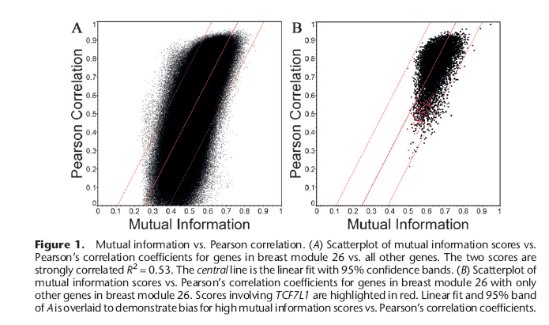
ARACNE algorithms

Slide 9
Approach- cont’d
Then cluster Cancer coexpression modules
Distance matrix for pairs of genes.
axy = ayx = 1-[I(x;y) / I(max)]^{s}.
Where I(max) is the maximum mutual information score in the matrix (i.e., the standardization factor), and s is an integer used to transform the unweighted adjacency matrix to approximate the scale-free criteria (Zhang and Horvath 2005; Khanin and Wit 2006).
The matrix is applied to hierarchical clustering.
The distance and clustering methods used have demonstrated superior performance in similar contexts (Gibbons and Roth 2002).
Dynamic Tree Cut algorithm (Langfelder et al. 2008) to cut into modules.
Module robustness test, remove 0~1% of genes in an example module 26.

Slide 10
Module clustering results

Slide 11
Mapping mutations to coexpression modules
each mutated gene was counted only once within a module
the number of mutated genes mapping to each module was evaluated by the hypergeometric distribution
no significant trend for mutation enrichment within modules containing mutated genes with longer coding regions

Slide 12
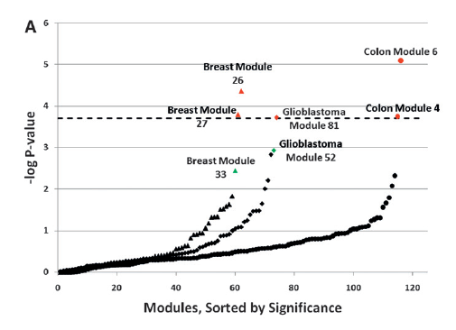

Slide 13
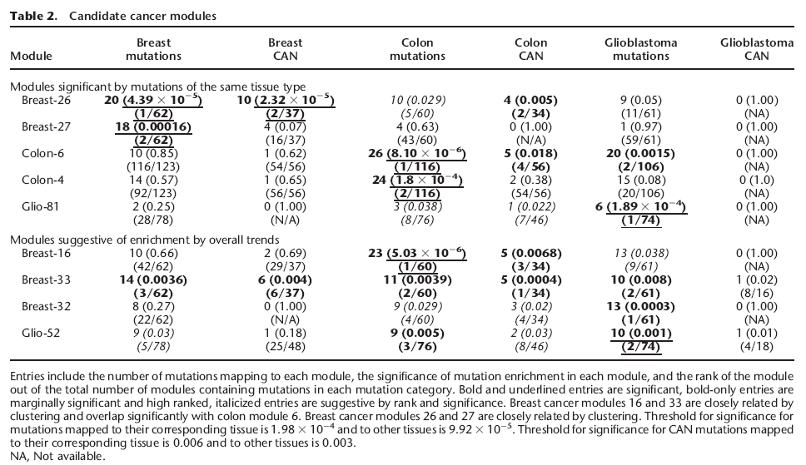

Slide 14
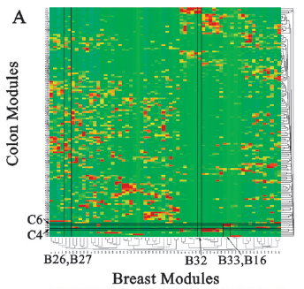

Slide 15
Characterization of significant module
gene ontology, literature, and interaction searches in order to characterize the molecular relationships between the mutated genes in breast cancer module 26

Slide 16
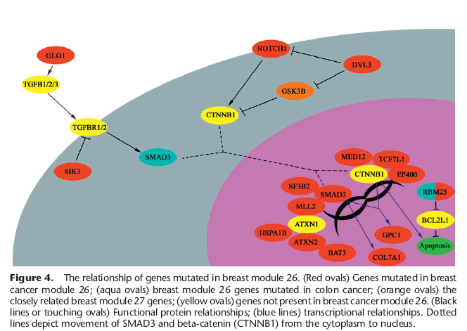

Slide 17
summary
Promising tool to identify driver mutation infrequent through identify the pathway first.
module enrichment will be observed in different-sized modules --- simpson’s paradox, tree cut threshold.
The next level is interplay between pathways.
Will be intuitively better incorporating impact analysis such as ours.

