Slide 1
A human phenome-interactome network of protein complexes implicated in genetic disorders
Kasper Lage, E Olof Karlberg, Zenia M Størling, Páll Í Ólason, Anders G Pedersen, Olga Rigina, Anders M Hinsby, Zeynep Tümer, Flemming Pociot, Niels Tommerup, Yves Moreau & Søren Brunak
Nature Biotechnology 25, 309 - 316 (2007)

Slide 2
Main Goal
Systematic investigation of protein complexes associated with human disease to elucidate cellular mechanisms underlying various disorders.
Prioritize positional candidates identified by linkage analysis or association studies.

Slide 3
Main Concepts/Assumptions
Some diseases have similar clinical manifestations (phenotype) which could be caused by different genes that are part of the same functional module.
Protein complexes are often associated with human diseases and it is likely that defects in several protein complexes, alone or in combination, can cause overlapping clinical manifestations.
Assumption: mutations in different members of a protein complex( predicted from protein-protein interaction data) lead to comparable phenotypes, the similarities of which can be automatically recognized by text mining.
Phenome-interactome network is computational integration of phenotypic data with a high-confidence interaction network of human proteins which is required for analyzing many human diseases simultaneously.

Slide 4
Possible problems
There is no single standard vocabulary for phenotypic annotation in humans.
Protein interaction data are noisy, are scattered among different databases, and contain many false positive interactions.
Only a few large-scale protein interaction studies have been finalized for the human proteome, thus there is very little data of human protein interaction needed for a systematic study of protein complexes associated with human diseases.

Slide 5
Solution
Extensive data integration, including conservative incorporation of protein interaction data from model organisms, streamlining of human phenotype data and thorough testing of the resulting method.

Slide 6
Results
A quality-controlled interaction network of human proteins was constructed
A phenotype similarity scores have been calculated.
The analysis of the resulting human phenome-interactome network revealed that 506 disease-associated protein complexes span a wide range of inherited diseases categories.
A Bayesian predictor was trained to prioritize candidates in 870 linkage intervals:
Candidates were assigned to protein complexes
These complexes were ranked based on the phenotypes associated with its members by text mining

Slide 7
Key steps in scoring each candidate in a linkage interval

Slide 8
Measuring phenotype similarity scores
Inspired by text-mining techniques the authors created a scoring scheme that quantitatively measures the phenotypic overlap of OMIM records.
The method amounts to detecting words from Unified Medical Language System (UMLS) that are
Common to the description of the two phenotypes
Do not occur too frequently among all phenotype descriptions.

Slide 9
Measuring phenotype similarity scores cont’d
OMIM records were parsed with MetaMap Transfer (MMTx) which maps text to the UMLS metathesaurus concepts.
A phenotype vector was created for every parsed record
This vector consists of weighted medical terms present in the record
To quantify the pairwise phenotypic overlap a cosine of the angle between normalized vector pairs was calculated.

Slide 10
Evaluation of phenotype similarity measuring method reliability
OMIM record pairs have been chosen as a benchmark for the automatically computed similarity score.
About 7000 of such pairs which had a high degree of overlap have been extracted from OMIM (see supplemental table 1)
OMIM’s cross-linking of the records is done manually by experts.
To ensure that the benchmarking set is reliable a random 100 pairs have been chosen and evaluated manually by the authors. It has been found that 94 out of the 100 were true positives (90% TP) meaning that over 90% of the pairs in 7000 set are high degree phenotypic overlap

Slide 11
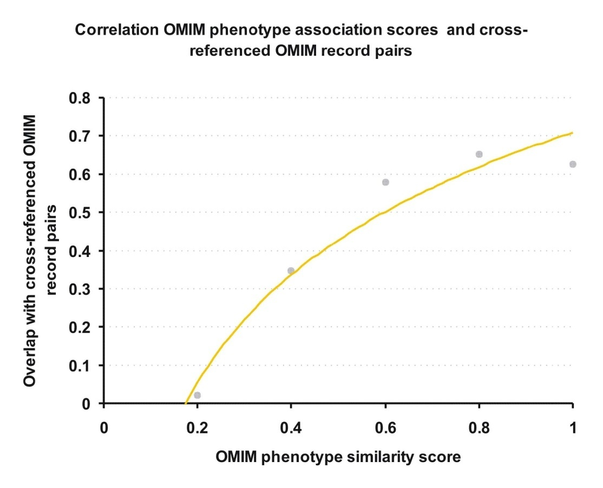
Evaluation of phenotype similarity measuring method reliability cont’d
The reliability of the phenotype similarity score was tested by fitting a calibration curve of the score against the overlap with OMIM record pairs.
Our phenotype similarity score directly correlates with the probability of overlap with these file pairs, showing that the score is a direct and reliable measure of phenotypic overlap between
the records represented by the vectors.

Slide 12
Constructing a scored network of human protein interactions
Human protein interaction network consists of data retrieved from several largest databases(MINT, BIND, IntAct, KEGG) and model organisms data.
A network-wide confidence score have been devised and tested for all interactions.
This score relies on network topology and considers:
Interactions from large-scale experiments generally contain more false positives than interactions from small-scale experiments
Interactions are more reliable if they have been reproduced in more than one independent interaction experiment

Slide 13
Constructing a scored network of human protein interactions cont’d
Probabilistic confidence score for all interactions in the network is based on topological scoring method (Lichtenberg et al.)
Every interaction was assigned a raw score (RS) from 0 to -∞, based on the topology of the network surrounding the interaction (i.e. number of non-shared interaction partners):
RS = -log((NS1 + 1) * (NS2 + 1))
NS1 and NS2 are the amount of non shared interaction partners of proteins 1 and 2 respectively.
To take into account the two issues mentioned before the following equation was devised for post-processing the raw score of a given interaction:
Score = RS / ∑1/log(int i)
where i is a publication showing the interaction and (int i) is the number of interactions in publication i

Slide 14
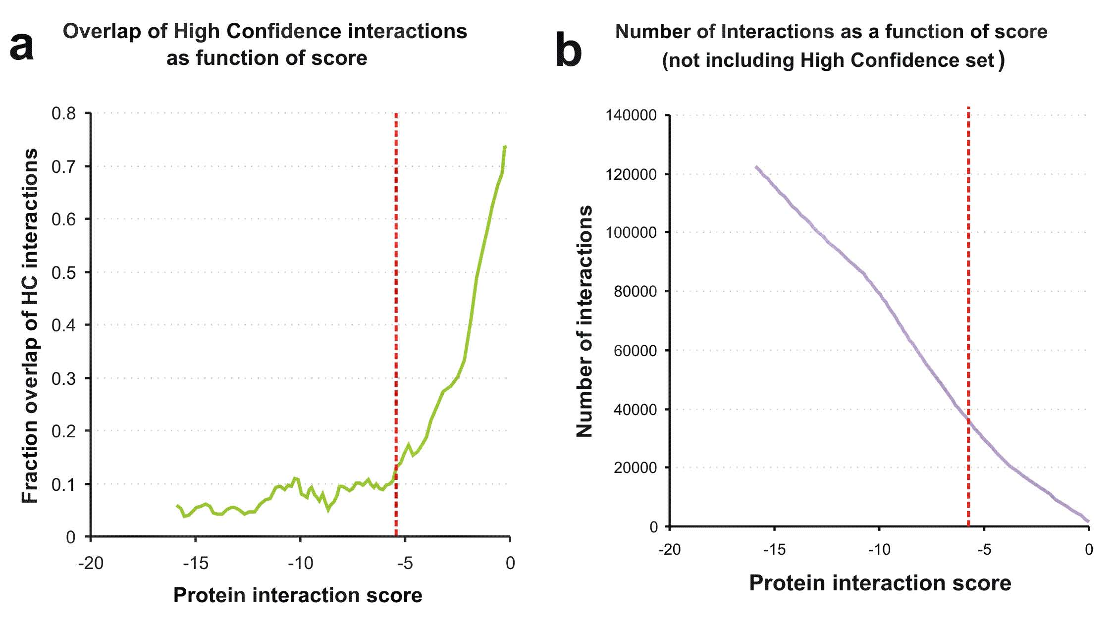
Constructing a scored network of human protein interactions cont’d
The reliability of the score as a measure of interaction confidence was confirmed by fitting a calibration curve of the score against overlap with a high confidence set of 35,000 human interactions.
A near exponential
correlation can be observed between overlap of interactions and confidence score above -5.5
(red dotted line) indicating this is the threshold for high quality interactions (red dotted line)
(a). The number of interactions in the network with a given interaction score (not including HC set) show that there are ~37,000 interactions scoring over -5.5 (red dotted line) (b).

Slide 15
Testing the predictor on 1404 linkage intervals
A Bayesian predictor was trained to rank known disease-causing proteins in linkage intervals.
The predictor was validated by fivefold cross-validation on a total of 1404 linkage intervals containing an average of 109 candidates and including one candidate known to be involved in the particular disease.
The biological interpretation of a high-scoring candidate is that this protein is likely to be involved in the molecular pathology of the disorder of interest, because it is a part of a high-confidence candidate complex in which some proteins are known to be involved in highly similar (or identical) disorders.

Slide 16
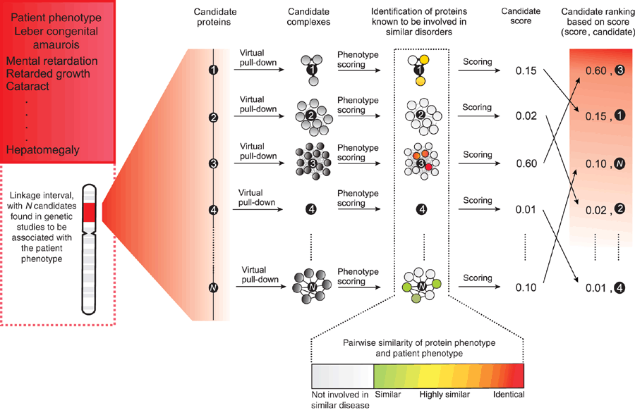
Testing the predictor on 1404 linkage intervals cont’d
Bayesian predictor takes as input the patient phenotype and a linkage interval.
The candidates are ranked as follows:
A given positional candidate is queried for high-scoring interaction partners. These interaction partners compose the candidate complex
Proteins known to be involved in disease are identified in the candidate complex, and pairwise scores of the phenotypic overlap between disease of these proteins and the candidate phenotype are assigned
Based on the phenotypes represented in the candidate complex, the Bayesian predictor awards a posterior probability score to the candidate complex.
All candidates in the linkage interval are ranked on the basis of this score.

Slide 17
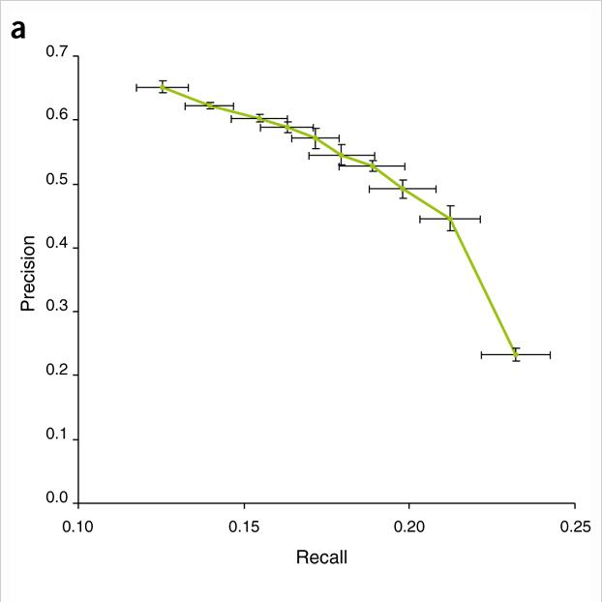
Performance of the Bayesian model relying on phenomic scoring of protein complexes associated with disease
Candidates scoring above 0.9 are correct in more than 65% of the cases
The results of prioritizing candidates in the 1404 test linkage intervals show that the predictor has both good precision and recall.
The method makes a prediction for a disease if the top-scoring gene for this disease has a score above threshold of 0.1 (prediction scoring below 0.1 approximate the chance of picking the correct gene randomly)
Precision = #of relevant genes retrieved / no. of genes retrieved
Recall = #of relevant genes retrieved / # of relevant genes

Slide 18
Sources of false positives
There are 2 main types pf failures to identify the relevant genes:
The proteins coded by the relevant genes do not have an interaction partner that is involved in a relevant phenotype (applies to 59% of all intervals). These types of failures could be either due to a lack of data or/and because some disease proteins do not interact with proteins involved in similar diseases.
There is a gene in the region considered a better candidate by the predictor (applies to 26% of all intervals). These 26% could in theory be correct predictions, as suggested by manual inspection of false predictions with high posterior probabilities.

Slide 19
Predicting novel disease gene candidates
The authors ranked the genes in 870 intervals linked to diseases from OMIM database which have no confirmed disease-causing genes.
A list of 113 candidates in 91 intervals was identified by the Bayesian predictor. In each of the 91 intervals at least one candidate scored above 0.2.
All prediction were followed up by the independent literature studies, where the distance of the predicted gene to the closest published high-resolution marker was investigated.
7 genes were located > 20 Mb from such markers.
24 of the predictions point to genes that are most likely true positives, but where the causative mutation has not yet been identified.
7 predictions point to genes where a causative mutation has been identified.
66 of the candidates belong to intervals where there is no evidence in the literature regarding a gene(s) that contributes to the pathology. The authors consider these as novel candidates

Slide 20
Predicting novel disease gene candidates cont’d
A few out 31 most likely true predictions
Disease (MIM number) | Gene (HUGO/Ensembl Acc) | Probability value | Cyto-genetic band
Pancreatic endocrine tumor 602011 | VHL ENSG00000134086 | 1.0000 | 3p25.3
Malaria, susceptibility to 609148 | TNF ENSG00000111956 | 1.0000 | 6p21.33
Cataract, nonnuclear polymorphic, congenital 601286 | CRYGC ENSG00000163254 | 1.0000 | 2q33.3

Slide 21
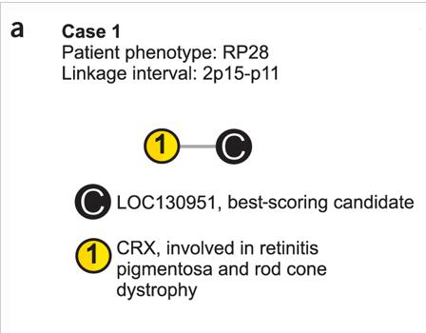
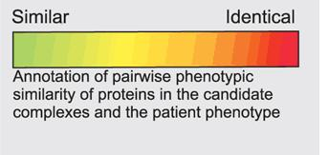
Case studies - 1
Retinitis pigmentosa is a clinically heterogeneous group of disorders. Common traits are night blindness, constricted visual field and retinal dystrophy.
LOC130951 is uncharacterized but evolutionary conserved (predicted not deleterious in snps3d)
CRX is a homeobox transcription factor known to be involved in retinitis pigmentosa and cone rod dystrophy (predicted deleterious in snps3d)

Slide 22
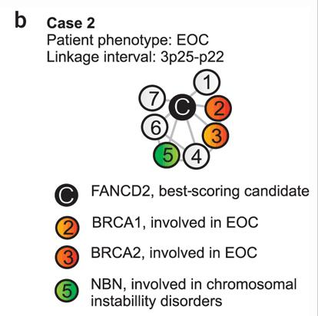
Case studies - 2
Epithelial ovarian cancer arises as a result of genetic alterations in the ovarian surface epithelium.
FANCD2 is part of the BRCA pathway in cisplatin-sensitive cells and is known to be involved in different types of cancer, but not epithelial ovarian.
BRCA1 and BRCA2 are well known to be related to the breast cancer.

Slide 23
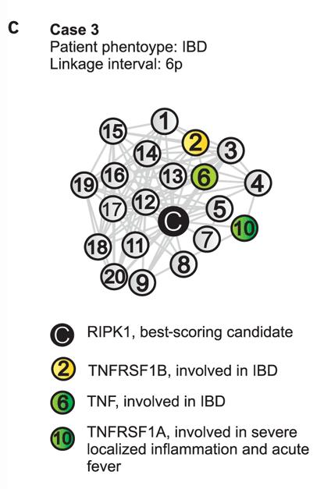
Case studies - 3
Inflammatory bowel disease is characterized by chronic, relapsing intestinal inflammation.
RIPK1 was predicted as the best candidate with score 0.9984 (predicted deleterious in snps3d)
TNFRSF1B, TNF and TNFRSF1A are all in the candidate complex.

Slide 24
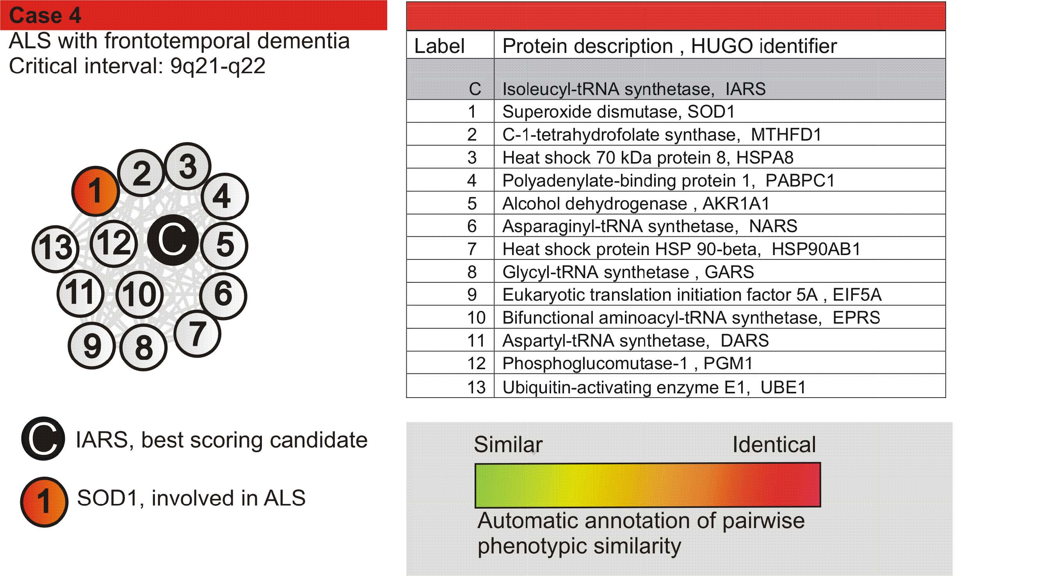
Case studies - 4
Amyotrophic lateral sclerosis with frontotemporal dementia is a degenerative motor neuron disorder characterized by muscular atrophy, progressive motor neuron function loss and bulbar paralysis.
Two likely candidates: BICD2 and IARS

Slide 25
Contribution
Created a database with 506 putative human disease complexes, determined by the current resolution data.
http://www.cbs.dtu.dk/suppl/dgf/
When checking the website I received the following message:
Our web server is currently DOWN. We will be up again shortly.

Slide 26
Thank you
Questions?

